Slide 1
PARTNER MEETING
RE-CVET
Pavol Krempasky
EACEA - Education, Audiovisual
and Culture Executive Agency
24-25/11/2016 Nicosia

Slide 2
Summary
EACEA – the Agency
Reporting, monitoring
New Skills Agenda for Europe

Slide 3
Education, Audiovisual and Culture Executive Agency (EACEA)
Operational since January 2006
Management of European funding
Currently one of the largest Executive Agencies with around 460 staff in 2015
Total 2014-2020 budget = €4,809 million

Slide 4
EACEA mandate 2014-2020
Erasmus+
Creative Europe
€ 3 306 million
€ 1 205 million
Europe for Citizens
EU Aid Volunteers
€ 165 million
€ 133 million

Slide 5
CVET projects approved in 2015
Year | Received Applications | Selected Applications
2015 | 10 | 2

Slide 6
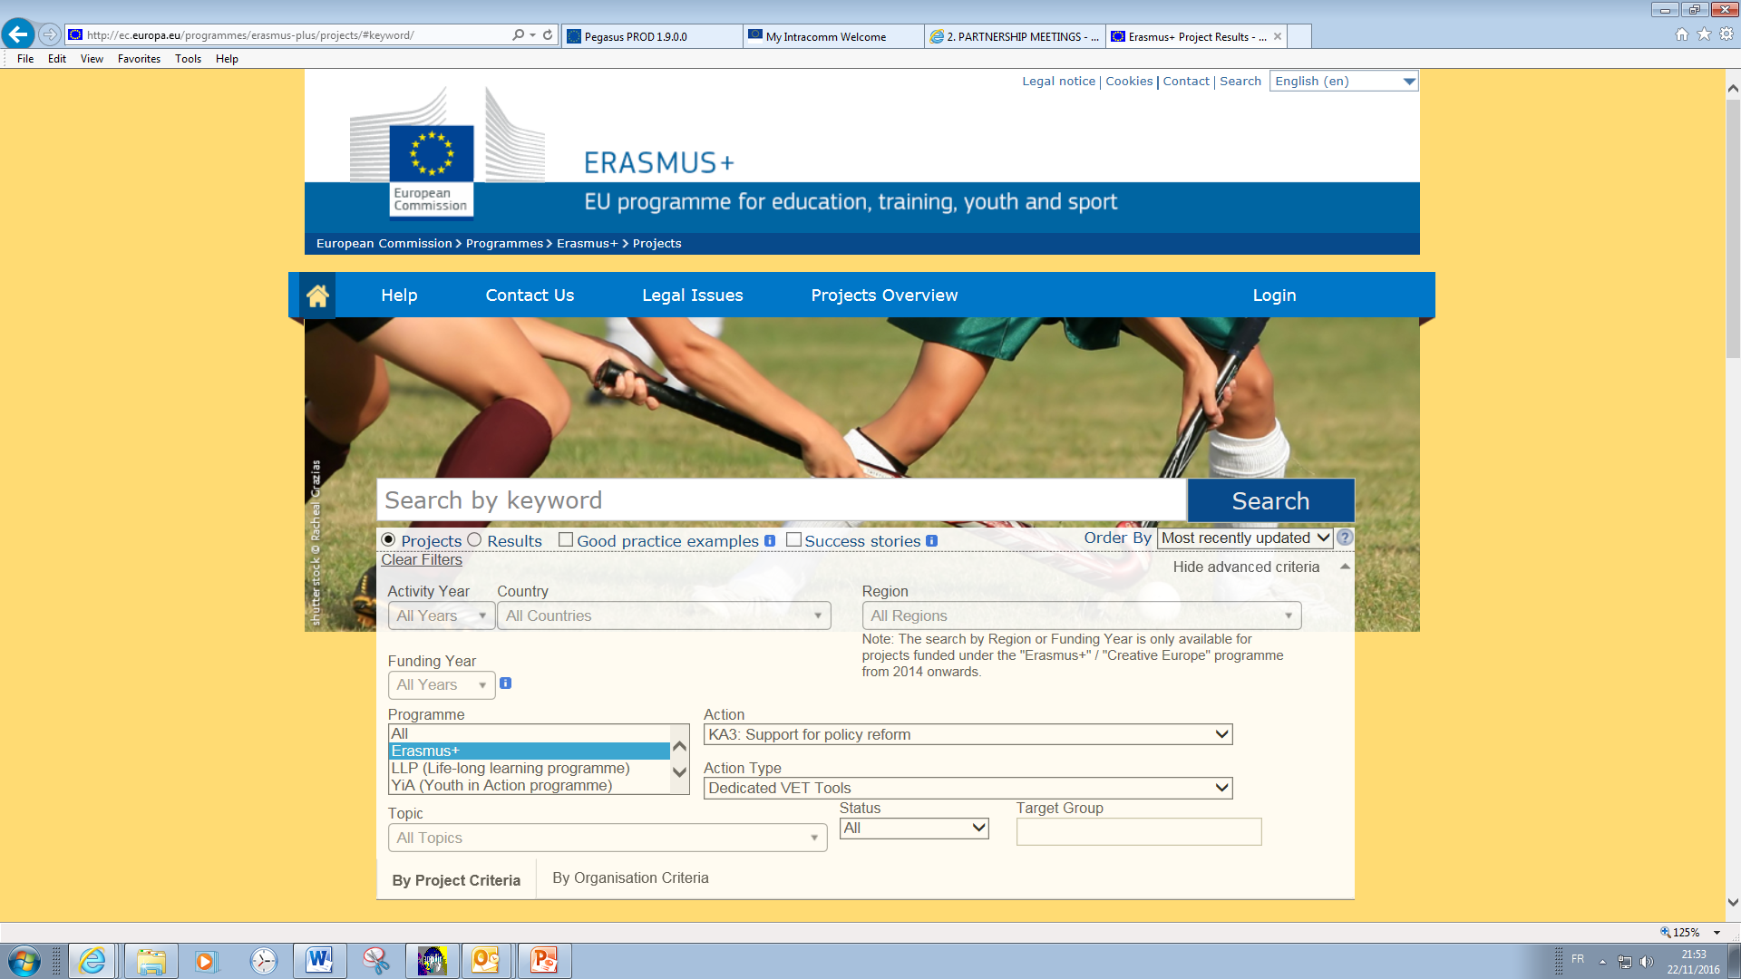
Erasmus+ dissemination platform
http://ec.europa.eu/programmes/erasmus-plus/projects

Slide 7
Tips for reporting
Information on monitoring - http://eacea.ec.europa.eu/erasmus-plus/beneficiaries-space/call-eacea-042015-%E2%80%93-comprehensive-policy-frameworks-for-cvet_en (page 7-9)
Collect info
Use the correct Report form (e-report for the final report)
Discuss with beneficiaries, EACEA
Collect, check, send supporting documents
Keep all correspondence
Use the correct Handbook
Take into account holidays
Use logo and disclaimer
Update the project's web page

Slide 8
Tips for reporting
At final report stage upload the deliverables into Erasmus+ dissemination platform http://ec.europa.eu/programmes/erasmus-plus/projects
Consult the recommendations from the Agency
Beware of info plus requested by EACEA
Do not underestimate impact
Read application and call
Take into account specifics of your partners
Follow policy at EU/national level
Your internal communication platform will be accessible
Lessons learned help others

Slide 9
On 20 June the European Commission launched the New Skills Agenda for Europe to boost human capital, employability and competitiveness, adopted on 10 June 2016.

